Slide 1

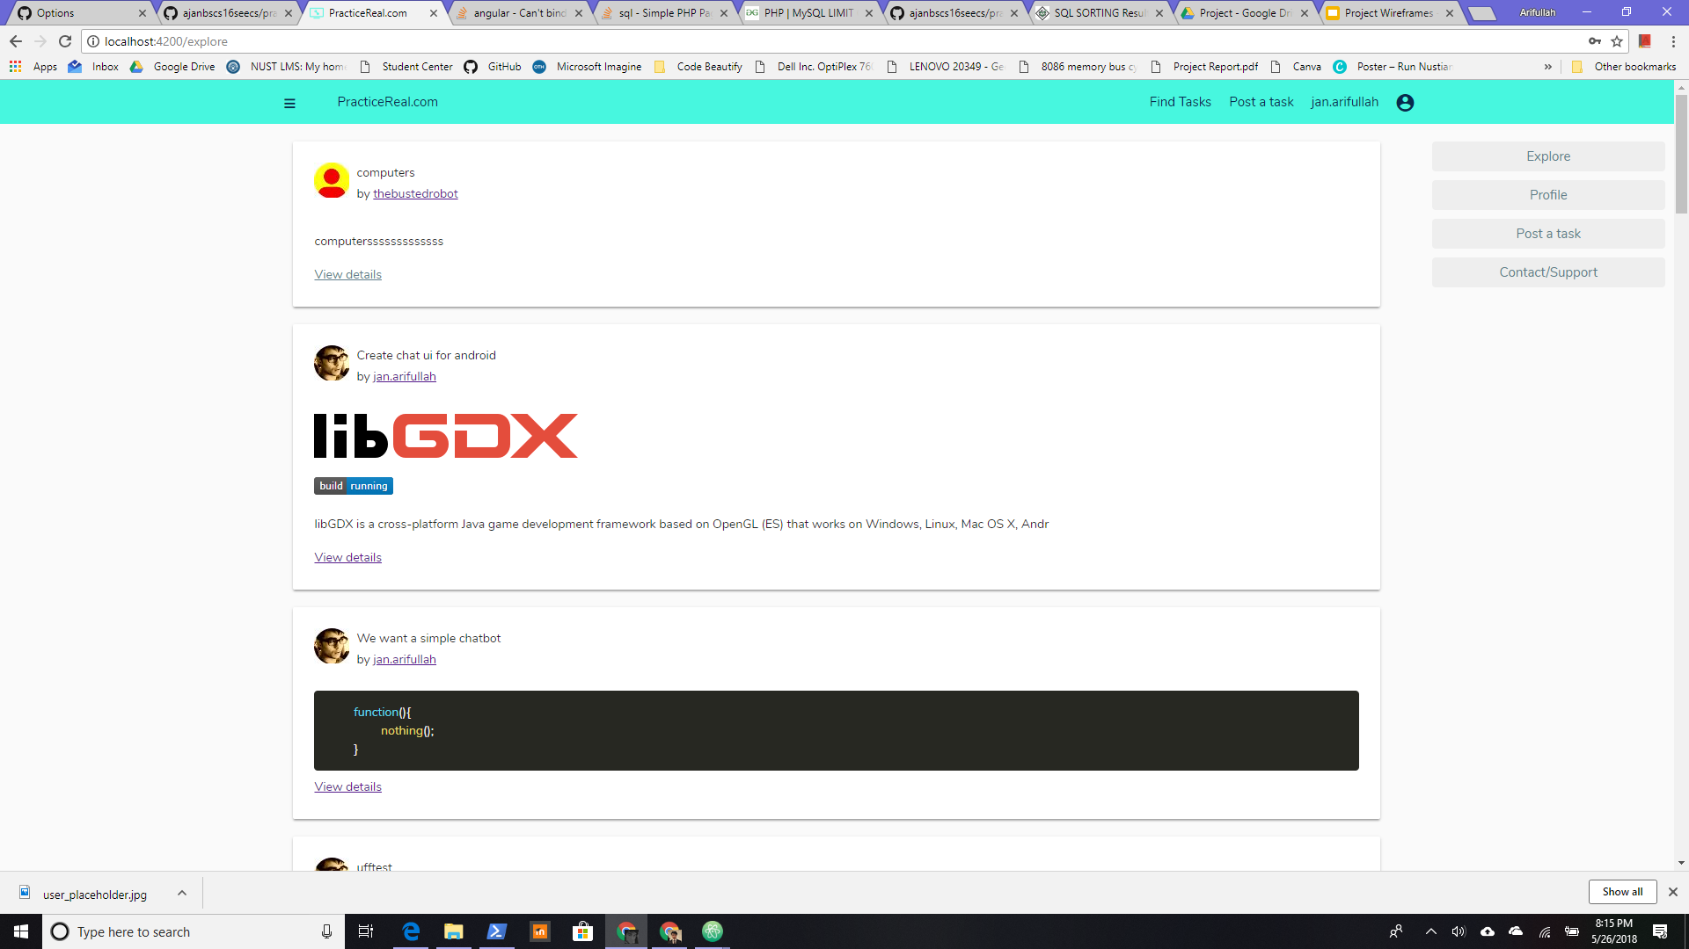

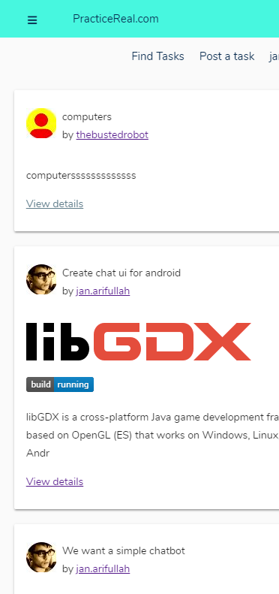
Project
PracticeReal.com
Problem statement and
solution proposal

Slide 2
Outline
The Problem
Solution Proposal
Our Effort
Code Design

Slide 3
The Problem

Slide 4
Problem statement
What people do today
From decades the students of universities and colleges solve trivial problems from textbooks which have no link with professional life. So when they go in there profession they don't know how to deal with real life scenarios in their respective professions.
Learning by studying long solved problems…
Gap between industry and education institutions

Slide 5
Solution Proposal
We are building a platform where we connect the industries having loads of technical, business, IT and mathematical problems. The students who want to have a practical experience in their field, solve them for free.

Slide 6

Solve Real
01
1
Learn by solving real world, trending problems in the industry.
-no need to learn by reinventing the wheel.

Slide 7

Find Solutions
02
Industry gets simple or independant tasks done for free.

Slide 8

Both happy...
03

Slide 9
Desktop
Single page application

Slide 10
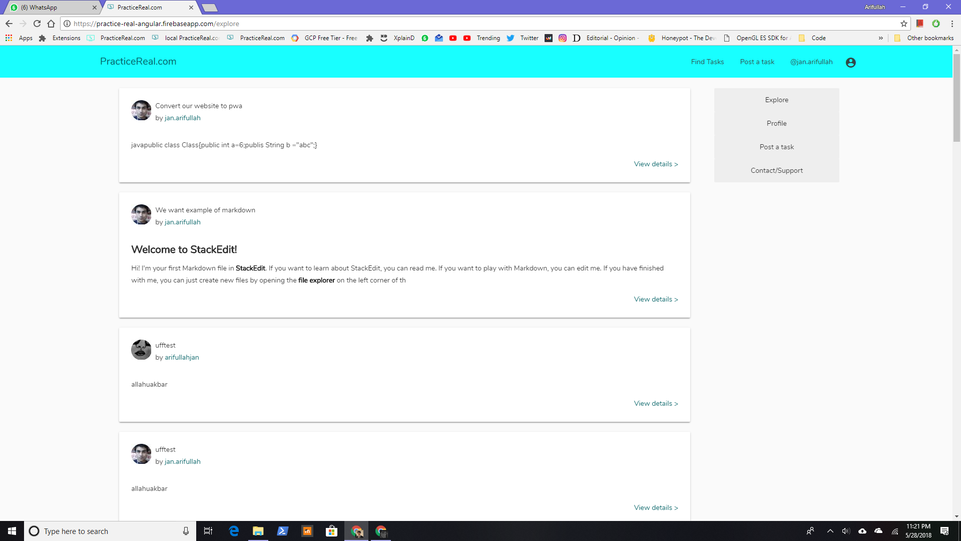
/explore or /explore/:tag
Task feed for all users
public

Slide 11
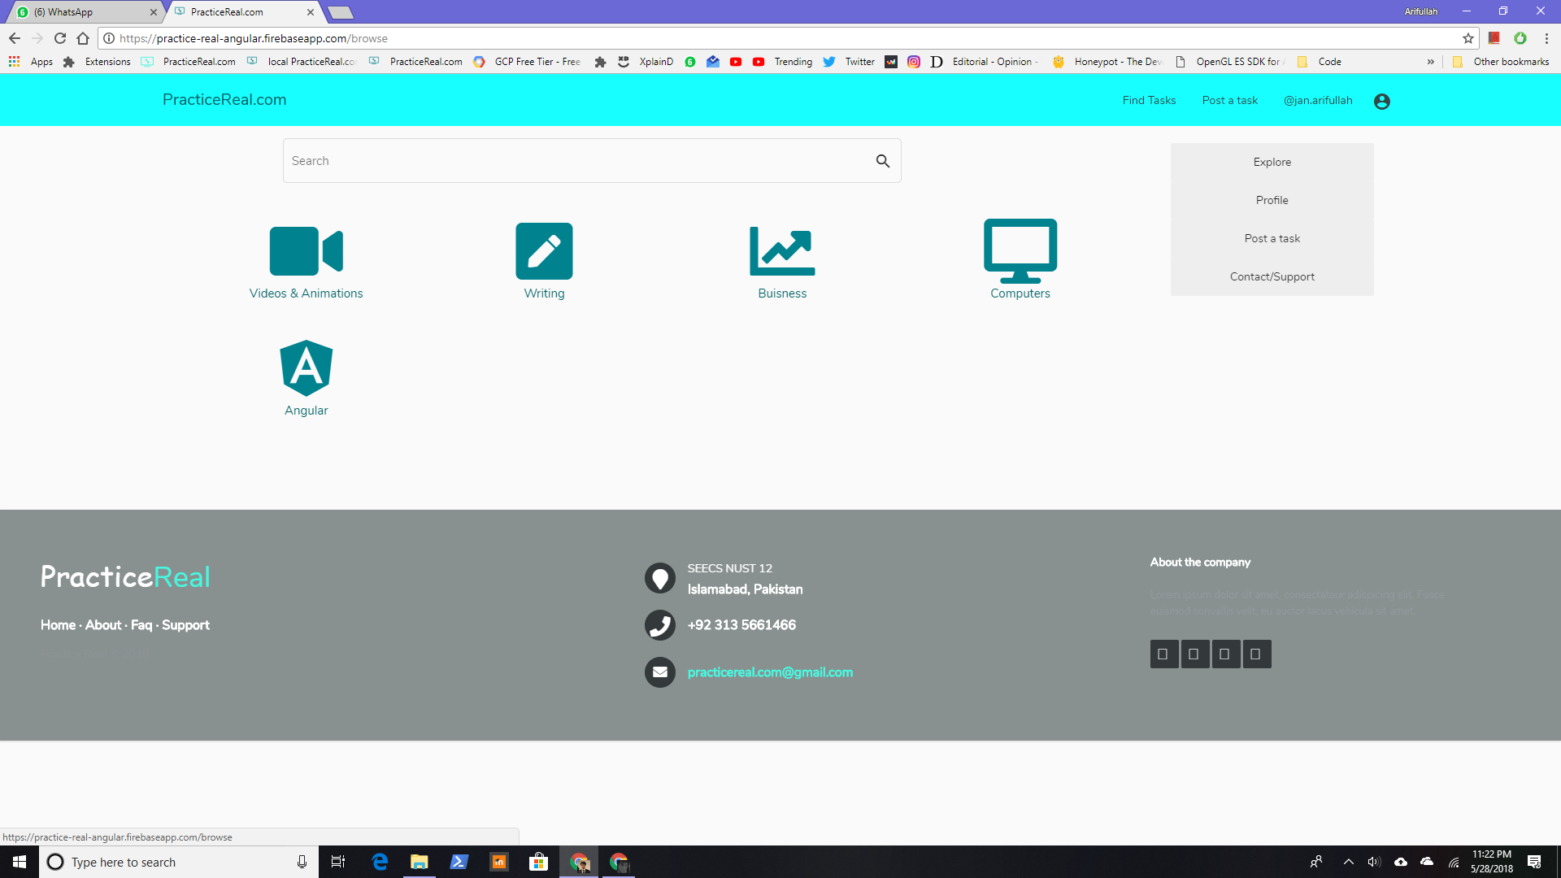
/browse
Search tag etc

Slide 12
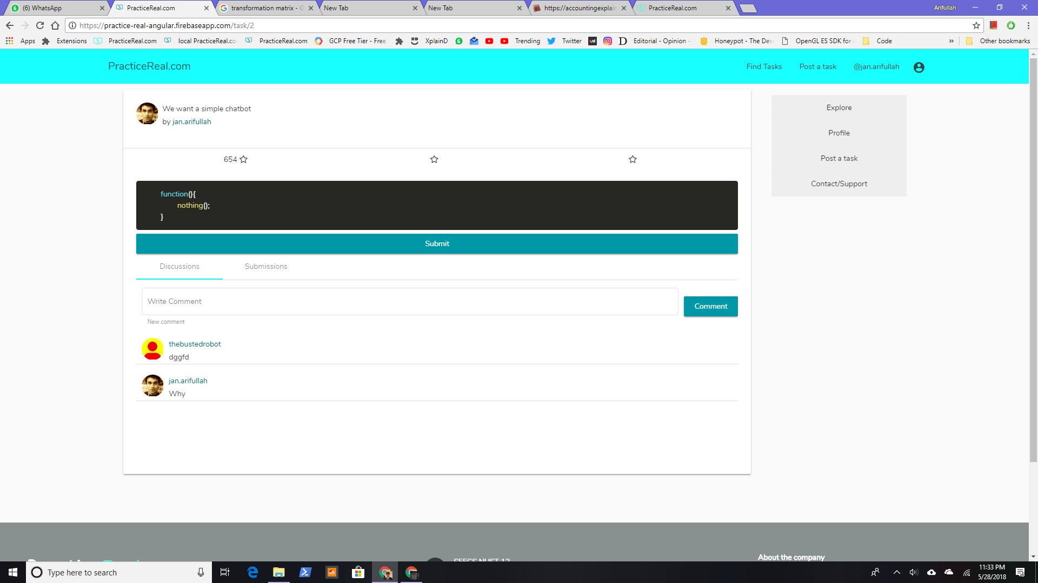
/task/:id
Task detail

Slide 13
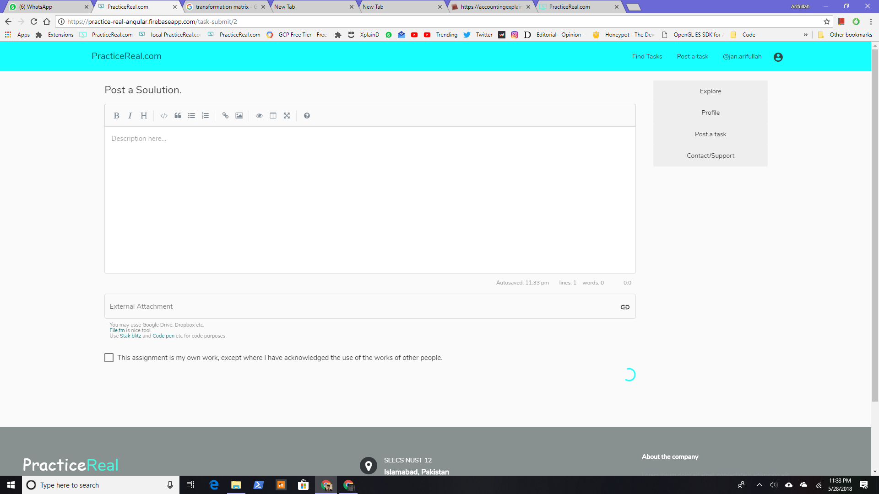
/task-submit/:id
Post a solution to a task

Slide 14
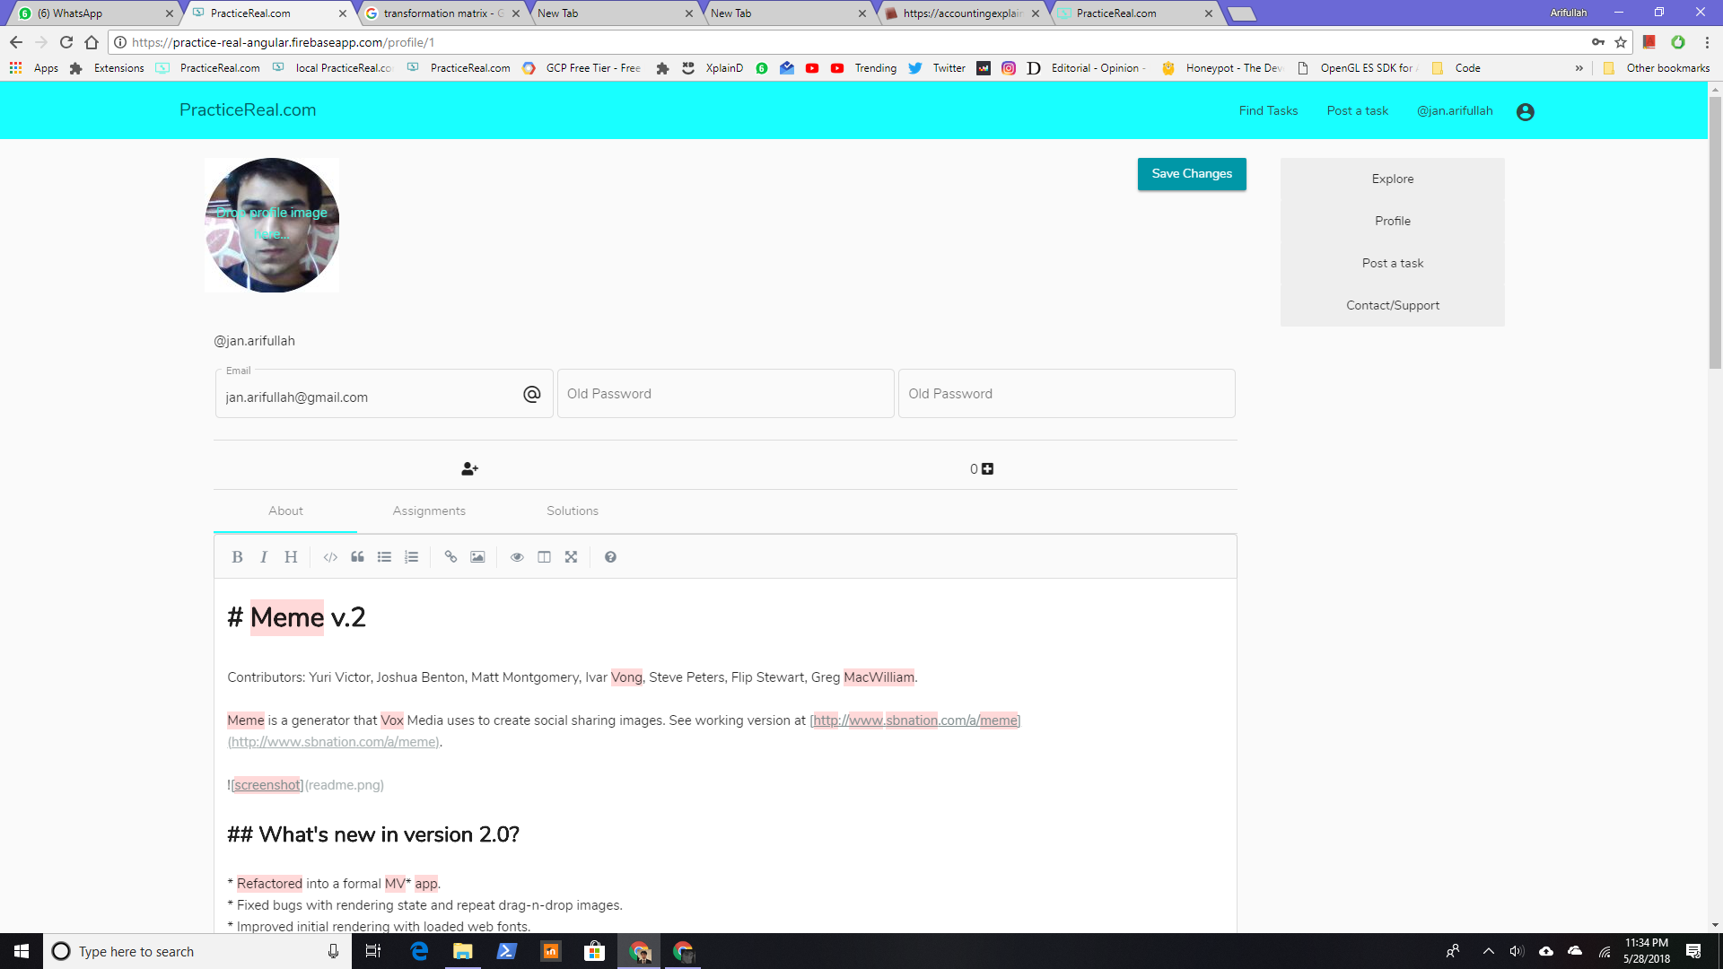
/profile/:id
Editable for own profile

Slide 15
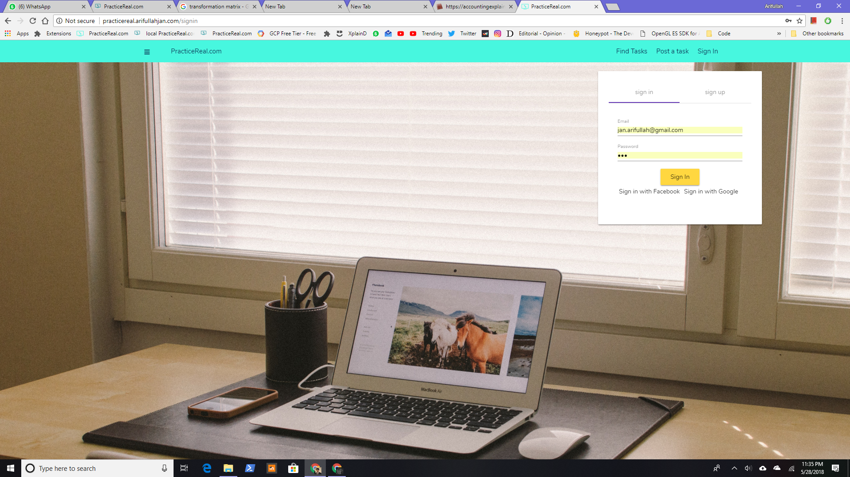
/signin

Slide 16
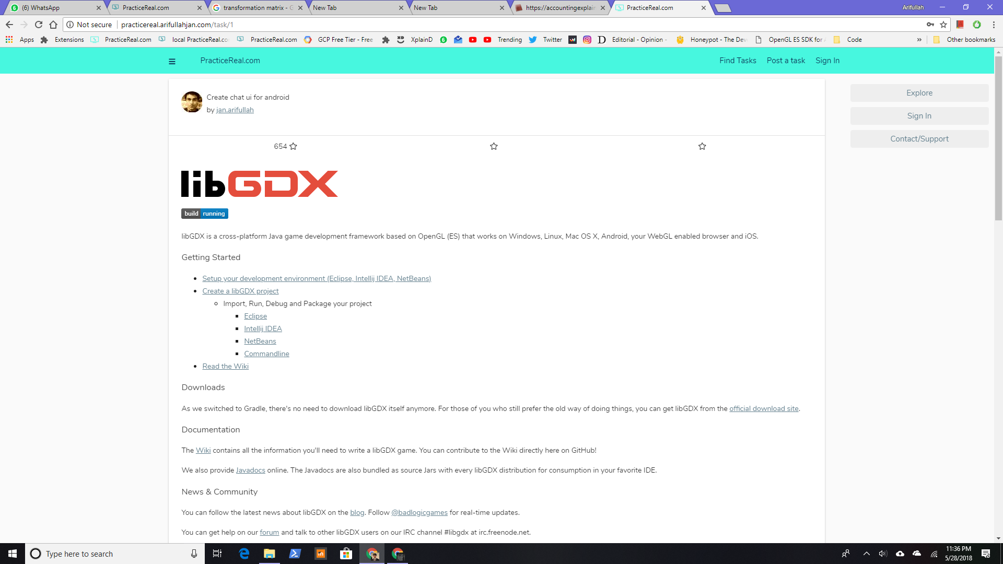
Markdown

Slide 17
Mobile

Slide 18
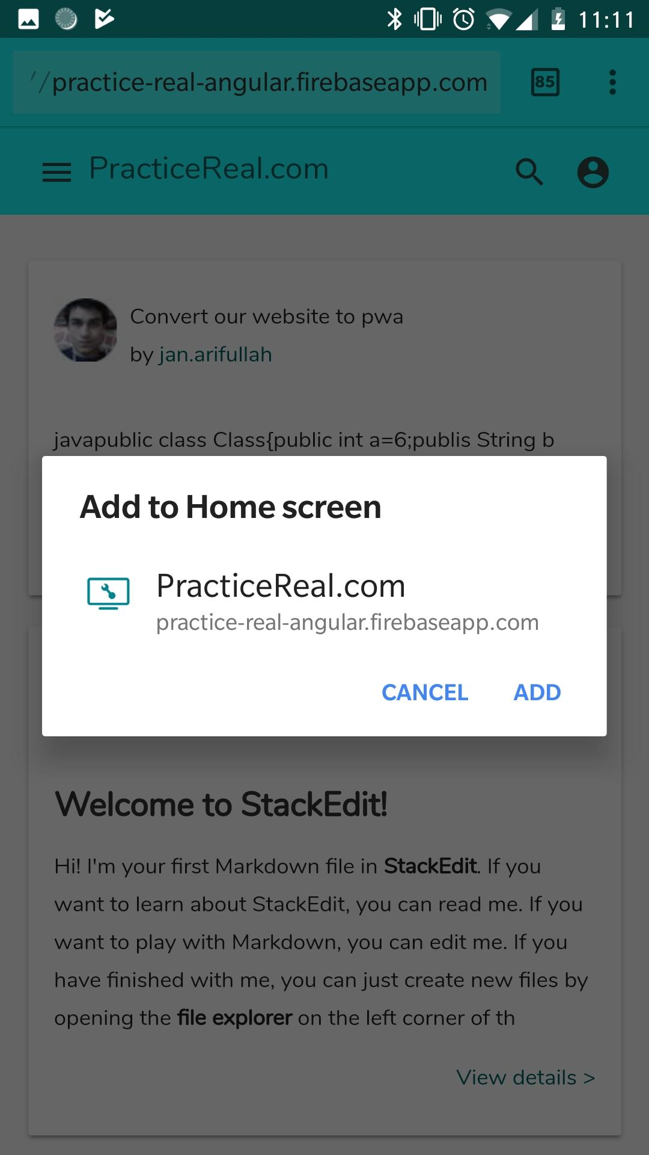
Progressive
Web
App

Slide 19
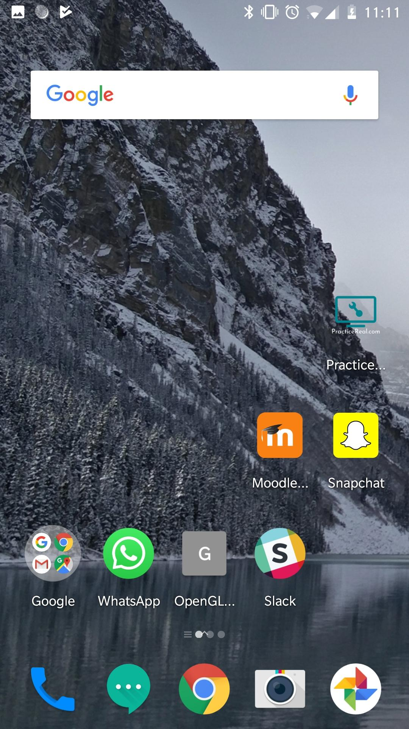
It behaves like a native app.

Slide 20
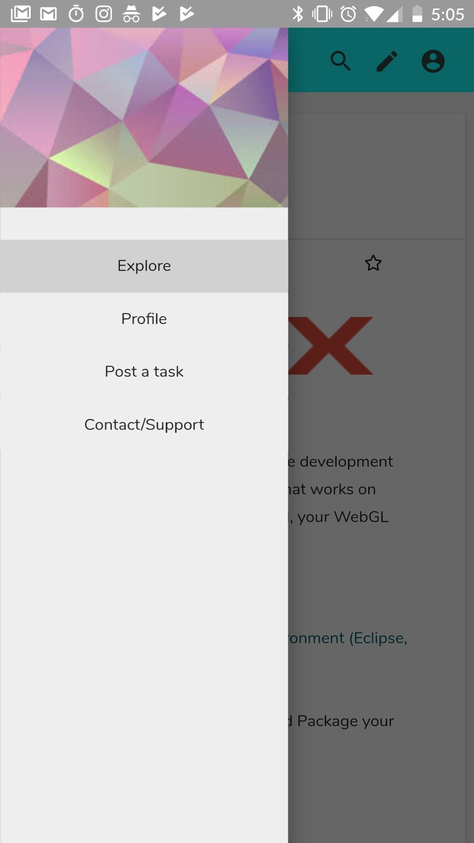
Navigation menu
for more native behaviour

Slide 21
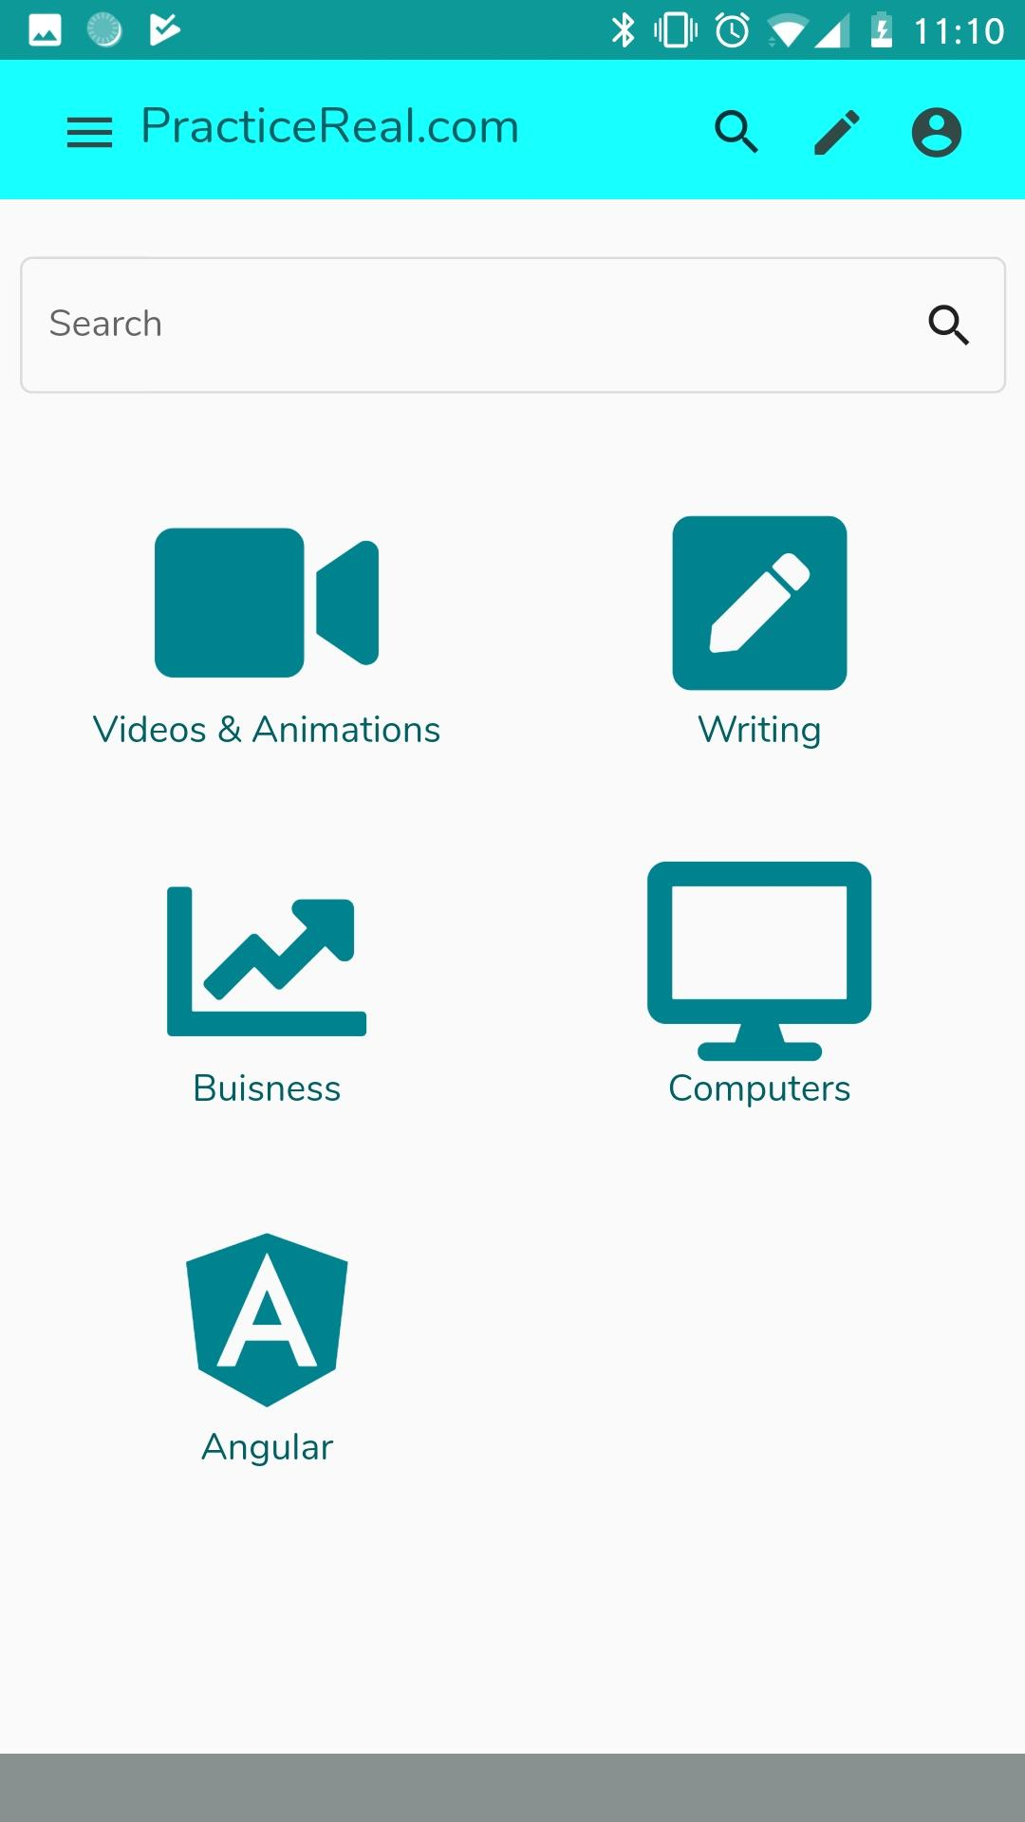
responsive

Slide 22
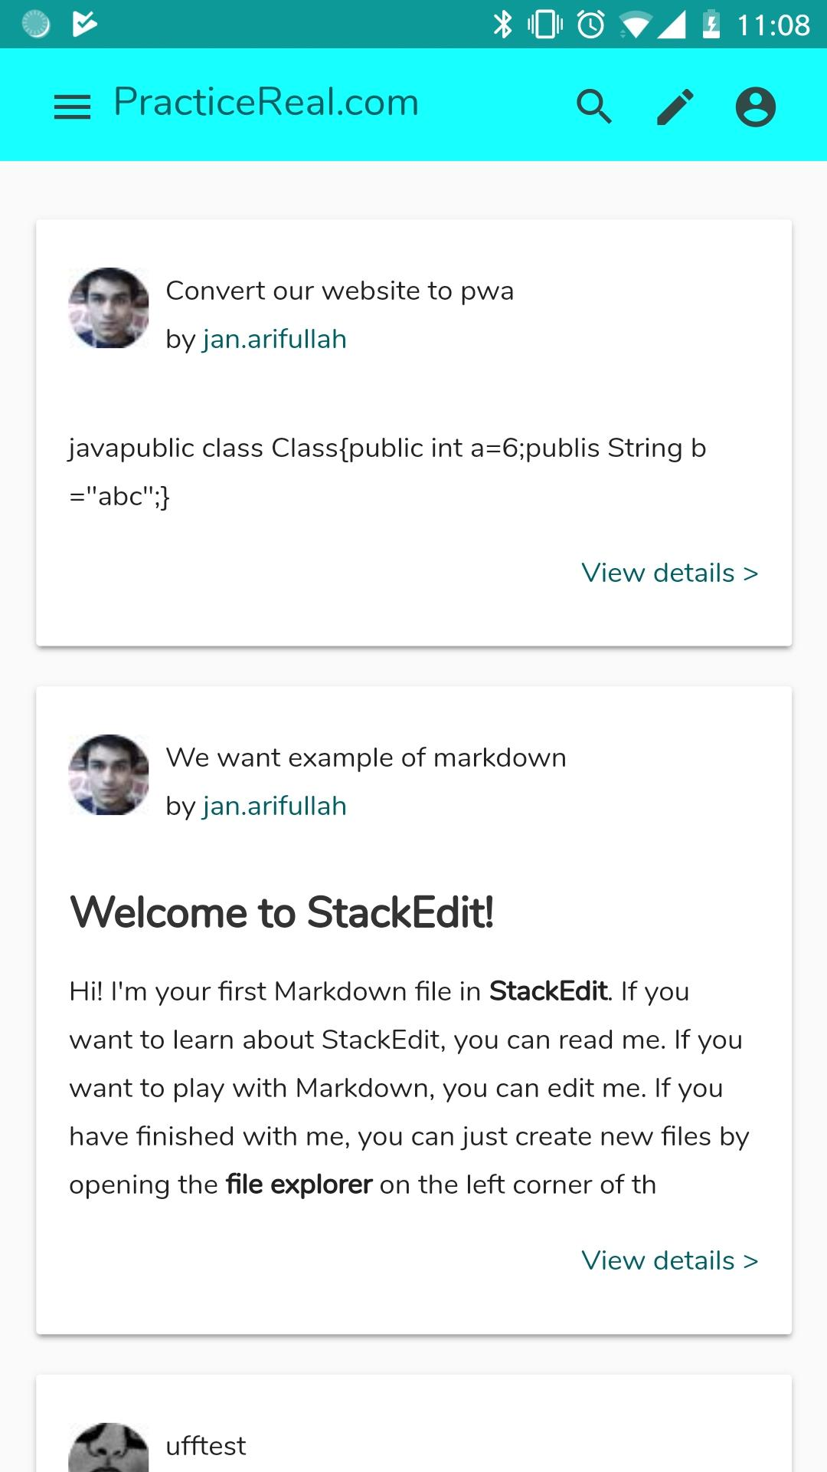
cards...

Slide 23
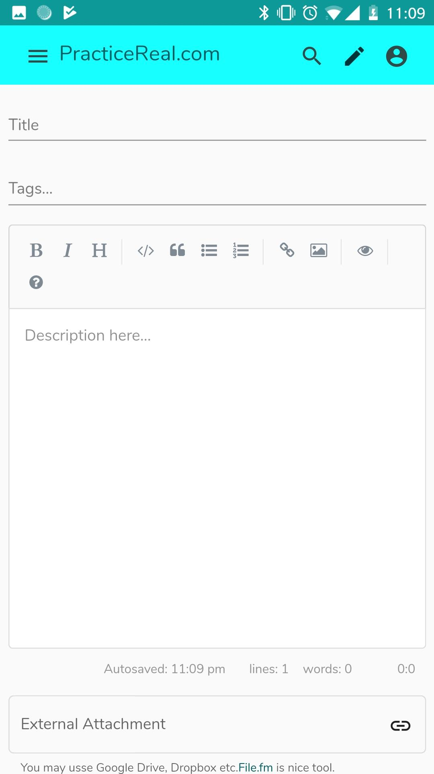
New task

Slide 24

Responsiveness
Icons instead of text in mobiles

Slide 25
Project
Angular 6
PhP
HTML/CSS
Typescript and javascript
Libraries and services used:
Cloudinary
Angular Material
Simple MDE
Markdown
Highlight.js

Slide 26
Design Architecture
Back End
Loosely coupled
REST api (returns json)
Front End
MVC
Component: (3 files)
Template
Design (optional)
View (ts)
Service
Responsible for service communication etc
Dependency injection

Slide 27
Optimizations
NoSQL in mysql
Stored some fields in json
Added redundancy for optimizations
Task contains username, profile picture,etc
No searching with “%something%”
authentication...

Slide 28
Authentication
Didn’t use php sessions
Gave user an encrypted token containing sufficient data.
Token is required for some endpoints.
We trust the token.
No need to query database for authentication.

Slide 29
Tools
Angular 6
PhP
HTML/CSS
Typescript and javascript

Slide 30
Thankyou!
noQuestions?

